Slide 1
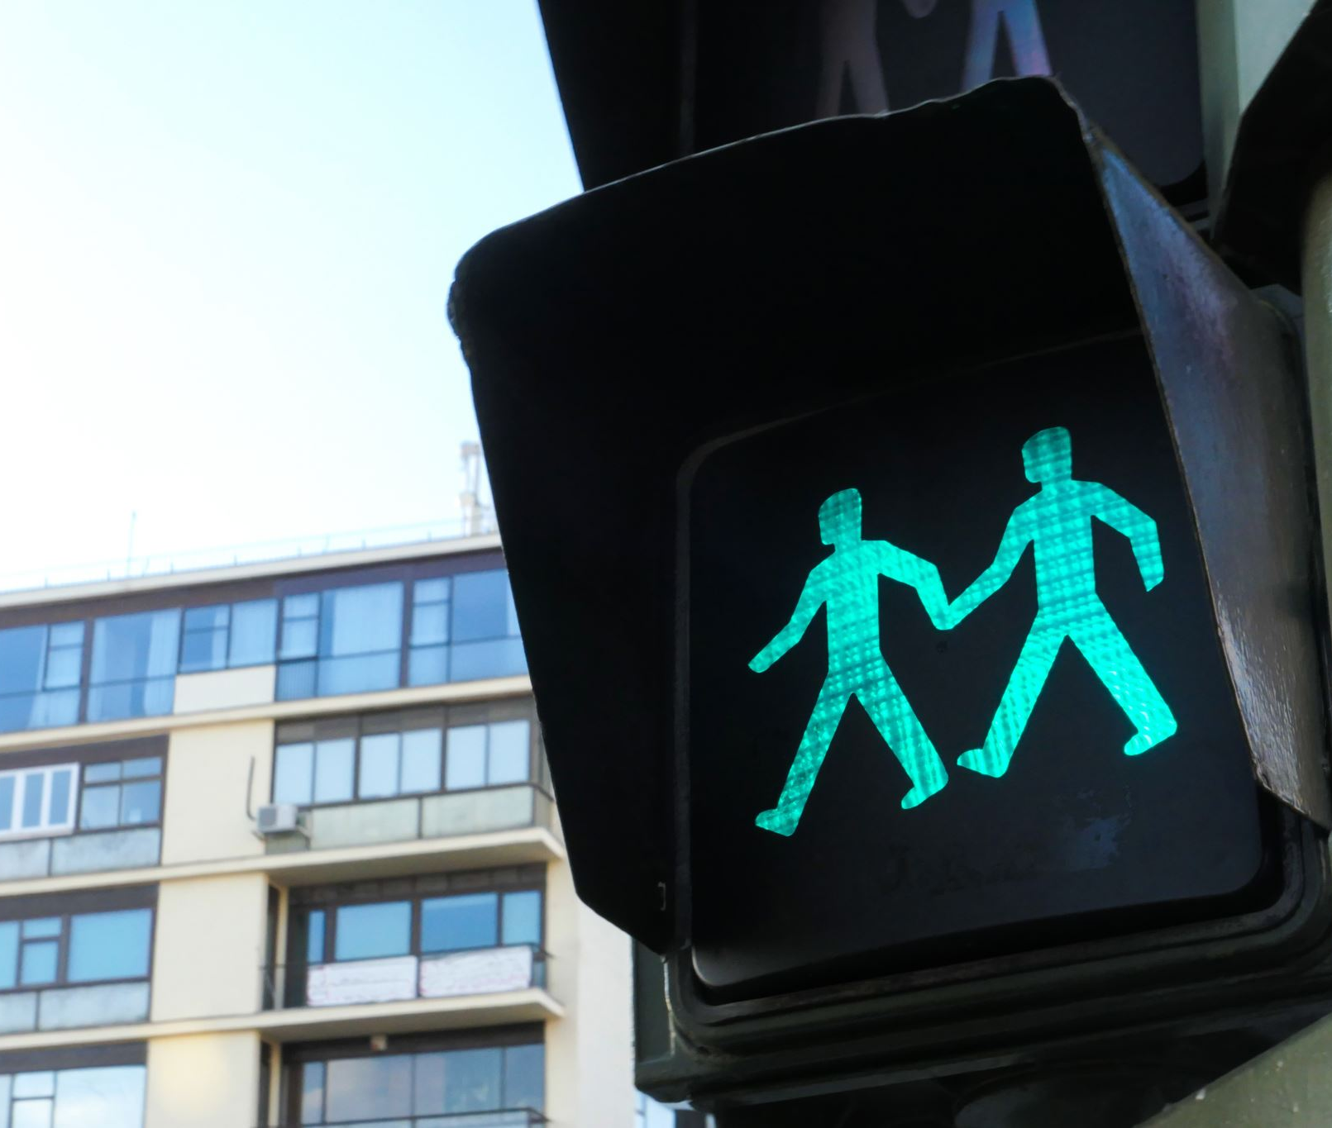
Semester project Traffic light system
Obi Nnamdi Elijah

Slide 2
DISCUSSION
MODEL
Model traffic light system with pedestrian crossing
STATE
State machine Diagram
CODE
Traffic light implementation with C/C++ language
SIMULATION
Traffic light simulation

Slide 3
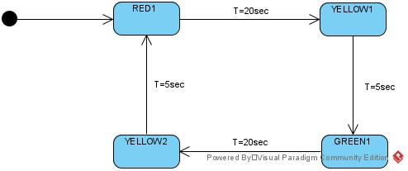
STATE MACHINE LOOP FOR CTL

Slide 4
void CTL()
{
unsigned long currentMillis = millis();
switch(CTL_state)
{
case CTL_GREEN:
digitalWrite(CTL_GREEN, HIGH);
digitalWrite(CTL_YELLOW1, LOW);
digitalWrite(CTL_YELLOW2, LOW);
digitalWrite(CTL_RED, LOW);
if ((currentMillis - CTL_GREEN_ENTRYMillis >= Interval10Sec)&&(Pb_Event == 1)) // Wait for 20000 millisecond(s)
{
CTL_state = CTL_YELLOW1;// Change the state of CTL to enter next case
CTL_YELLOW1_ENTRYMillis = millis();
}
else if ((currentMillis - CTL_GREEN_ENTRYMillis >= Interval20Sec)&&(Pb_Event == 0)) // Wait for 20000 millisecond(s)
{
CTL_state = CTL_YELLOW1;// Change the state of CTL to enter next case
CTL_YELLOW1_ENTRYMillis = millis();
}
break;
case CTL_YELLOW1:
digitalWrite(CTL_GREEN, LOW);
digitalWrite(CTL_YELLOW1, HIGH);
digitalWrite(CTL_YELLOW2, LOW);
digitalWrite(CTL_RED, LOW);
if ((currentMillis - CTL_YELLOW1_ENTRYMillis >= Interval10Sec))// Wait for 10000 millisecond(s)
{
CTL_state = CTL_RED; // Change the state of CTL to enter next case
CTL_RED_ENTRYMillis = millis();
}
break;
case CTL_RED:
digitalWrite(CTL_GREEN, LOW);
digitalWrite(CTL_YELLOW1, LOW);
digitalWrite(CTL_YELLOW2, LOW);
digitalWrite(CTL_RED, HIGH);
if ((currentMillis - CTL_RED_ENTRYMillis >= Interval20Sec))// Wait for 20000 millisecond(s)
{
CTL_state = CTL_YELLOW2;// Change the state of CTL to enter next case
CTL_YELLOW2_ENTRYMillis = millis();
}
break;
case CTL_YELLOW2:
digitalWrite(CTL_GREEN, LOW);
digitalWrite(CTL_YELLOW1, LOW);
digitalWrite(CTL_YELLOW2, HIGH);
digitalWrite(CTL_RED, LOW);
if ((currentMillis - CTL_YELLOW2_ENTRYMillis >= Interval10Sec)&&(Pb_Event == 0)) // Wait for 10000 millisecond(s)
{
CTL_state = CTL_GREEN;// Change the state of CTL to enter next case
CTL_GREEN_ENTRYMillis = millis();
}
break;
}
}
CTL LOOP CODE

Slide 5
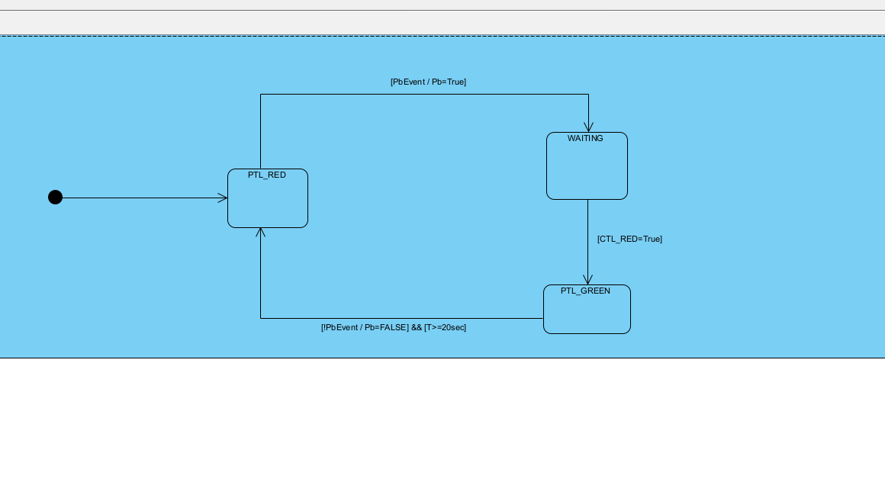
STATE MACHINE LOOP FOR PTL

Slide 6
void PTL()
{
switch(PTL_state)
{
case PTL_RED:
delay(20);/*This very short delay is added to help the simulation software
transition effortlessly*/
//CODE FOR WHAT IT DOES
digitalWrite(PTL_RED, HIGH);
digitalWrite(PTL_GREEN, LOW);
if(Pb_Event == 1) //CHECK FOR IF PedButton has been pushed
{
//Change state of PTL to WAITING
PTL_state = WAITING;
}
break;
case WAITING:
delay(20);/*This very short delay is added to help the simulation software
transition effortlessly*/
digitalWrite(PTL_RED, HIGH);
digitalWrite(PTL_GREEN, LOW);
if(Pb_Event == 1) //REMEMBER TO CHANGE THIS LINE OF CODE TO: Check if CTL_state is in CTL_RED case
{
//change state of PTL to PTL_GREEN
PTL_state = PTL_GREEN;
}
break;
case PTL_GREEN:
delay(20);/*This very short delay is added to help the simulation software
transition effortlessly*/
//CODE FOR WHAT IT DOES
digitalWrite(PTL_RED, LOW);
digitalWrite(PTL_GREEN, HIGH);
delay(20000);
Pb_Event=0;
PTL_state = PTL_RED;
break;
}
}
void triggerISR()
{
Pb_Event=1;
}
void triggerISR()
{
Pb_Event=1;
Pb_EventMillis = millis(); // save the time just when interrupt changes state of Pb_Event
}
PTL LOOP CODE

Slide 7
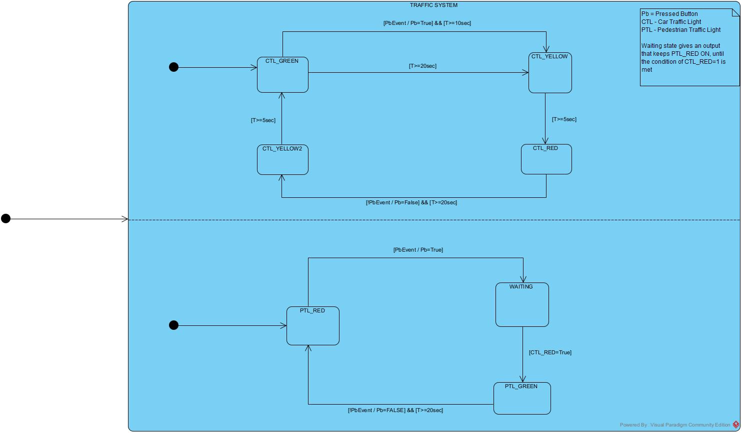
State machine model

Slide 8
#include <stdio.h>
#include <stdlib.h>
/* setting up the Pin names and pin number on Arduino*/
#define CTL_GREEN 13
#define CTL_YELLOW1 12
#define CTL_YELLOW2 11
#define CTL_RED 10
#define PTL_GREEN 9
#define PTL_RED 8
#define PedButton 2
#define WAITING 0
// Initializing a variable for state switch
int PTL_state = PTL_RED;
int CTL_state = CTL_GREEN;
// This will store last time global state variable was updated
unsigned long CTL_GREEN_ENTRYMillis = 0;
unsigned long CTL_YELLOW1_ENTRYMillis = 0;
unsigned long CTL_YELLOW2_ENTRYMillis = 0;
unsigned long CTL_RED_ENTRYMillis = 0;
unsigned long PTL_GREEN_ENTRYMillis = 0;
unsigned long Pb_EventMillis = 0;
// interval at which to change state (milliseconds)
// constants won't change:
const long Interval20Sec = 20000;
const long Interval10Sec = 10000;
const long Interval5Sec = 5000;
volatile int Pb_Event = 0; /*Initializing a point to store the state of the Button*/
void setup()
{
//Pin Set-up
pinMode(PTL_RED, OUTPUT);
pinMode(PTL_GREEN, OUTPUT);
pinMode(CTL_GREEN, OUTPUT);
pinMode(CTL_YELLOW1, OUTPUT);
pinMode(CTL_YELLOW2, OUTPUT);
pinMode(CTL_RED, OUTPUT);
pinMode(PedButton, INPUT);
//Setting all PTL pins to Low
digitalWrite(PTL_RED, LOW);
digitalWrite(PTL_GREEN, LOW);
digitalWrite(CTL_GREEN, LOW);
digitalWrite(CTL_YELLOW1, LOW);
digitalWrite(CTL_YELLOW2, LOW);
digitalWrite(CTL_RED, LOW);
attachInterrupt(digitalPinToInterrupt(PedButton), triggerISR, RISING);
}
void loop()
{
CTL();
PTL();
}
Variable Initialization, setup and loop

Slide 9
Simulation link
https://www.tinkercad.com/things/91Whb08ycP3-tls-test/editel?sharecode=m2hhgozB5XtyPvsXZVNdt6_qKi2E5OnmIwP0xG28WeU

Slide 10

Thank you

